Slide 1
Deep Dive into Memory-Optimized TempDB
Haripriya Naidu
She/Her
Database Administrator
EightKB - 8/21/2025

Slide 2




Haripriya Naidu
SQL Database Administrator
11 years
AWS Certified Solutions Architect
Speaker
Blogger
New Stars of Data 2024
gohigh.substack.com
linkedin.com/in/haripriya-naidu1215/
github.com/haripriyasb/MemoryOptimizedTempDB

Slide 3
What we usually do
Notice TempDB contention
Add datafiles
Wonder why it isn’t solving the issue

Slide 4
PAGE
LATCH?
Overview
YES
TempDB?
RESOLVED IN SQL 2022
YES
PFS GAM ? SGAM
Add 4 datafiles of equal size
Check Contention
Add 4 more datafiles of equal size
YES
YES
NO
System objects?
Cache #temp Don’t drop #temp
Check Contention
In-memory tempdb metadata feature in SQL2022
YES
YES

Slide 5
Agenda
Purpose of this feature
Key benefits
Usage and Implementation
Limitations and Management Techniques
Level 300+

Slide 6
Supported Versions and Editions
SQL 2019+
Enterprise
Developer
Feature NOT available in
Standard Edition
Azure SQL database
Azure SQL Managed Instance

Slide 7
Memory Optimized TempDB Feature
New feature starting SQL Server 2019
Moves 12 system objects to memory
Lock-free in memory
Removes bottlenecks by handling metadata in memory
No Locks
TempDB Drive
Memory
All objects of TempDB
System objects
#temptables
##globaltemptables
#tablevariable
Internal objects
12 system objects
#sysidxstats
#sysallocunits
#sysrscols
#sysrowsets
……..

Slide 8
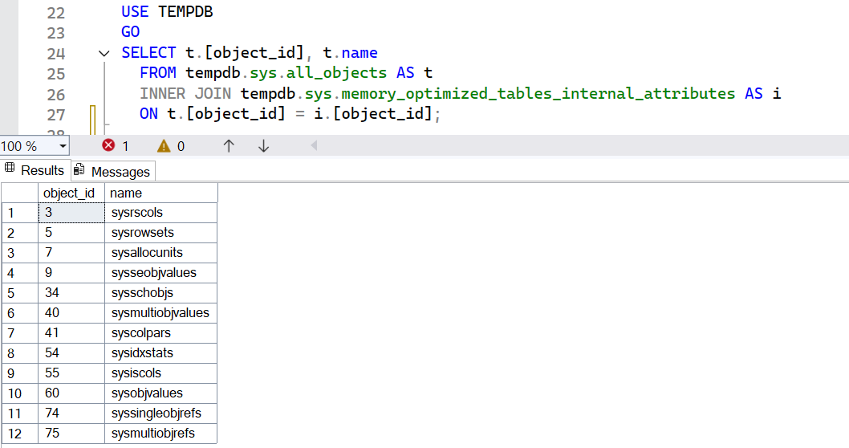
System Objects Moved to Memory

Slide 9
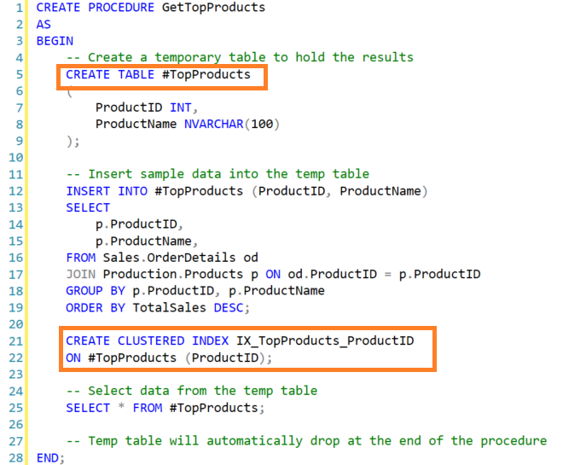
What happens internally
Create or alter #temp
Insert metadata
Get a pagelatch on system objects

Slide 10
1000s of concurrent executions
Create #temp
Alter #temp
Create #temp
Alter #temp
Create #temp
Alter #temp
Insert metadata
Contention
Get a pagelatch on system objects

Slide 11
Feature is enabled
Create #temp
Alter #temp
Create #temp
Alter #temp
Create #temp
Alter #temp
Insert metadata
NO Locks,
NO Contention
System objects
in memory

Slide 12
When to Enable This Feature
Too many stored procedures run concurrently where there are temp table DDLs
Usually, very busy OLTP environments
Check your collections or monitoring tool

Slide 13
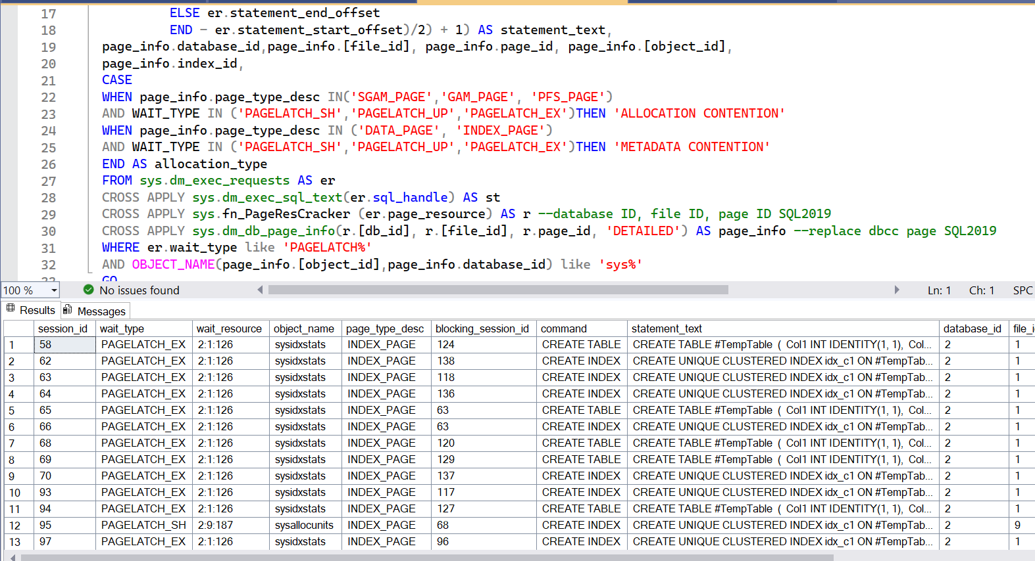
When to Enable This Feature
Strictly for
TempDB
Pagelatch wait type
12 system objects

Slide 14
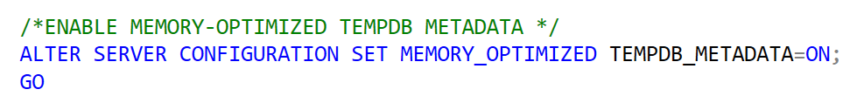
How to Enable this Feature
Disabled by default
Needs restart of SQL service after enabling
Hekaton DLL’s get configured
https://learn.microsoft.com/en-us/shows/data-exposed/how-and-when-to-memory-optimized-tempdb-metadata

Slide 15
Which Queries Utilize This Feature
DDL operation on temporary objects
CREATE TABLE #temptable
ALTER TABLE #temptable
CREATE TABLE ##globaltemptable
DECLARE @tablevariable

Slide 16

Note!
Not whole of tempDB is in memory
Only the system tables of tempdb are in memory
Temp tables are created in tempdb drive and not in memory
TempDB Drive
Memory
#temptables
##globaltemptables
#tablevariable
Worktables
#sysidxstats
#sysallocunits
#sysrscols
#sysrowsets
……..

Slide 17
Benefits
Latch free and Lock free
Less metadata contention
Better performance

Slide 18
Memory

Slide 19
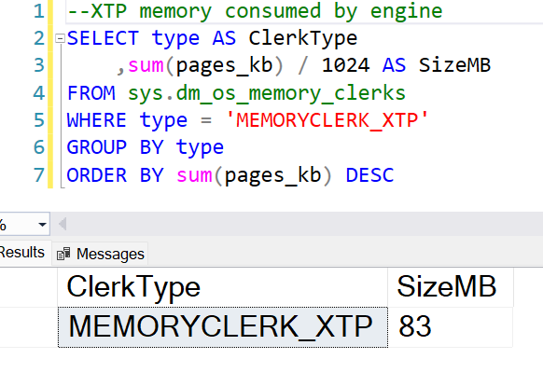
How much memory
Initially less than 100 MB
As temp object DDL
queries are run,
memory usage goes up
XTP - Xtreme Transaction
Processing

Slide 20
Where is it in memory
Separate part of memory
Not in buffer pool or cache
No filegroup configuration needed

Slide 21
Resource Governor

Slide 22
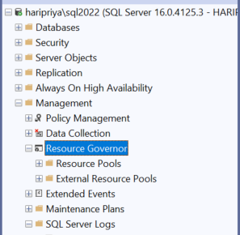

Resource Governor
You choose how much CPU, memory,
different workloads can use
Prevent one workload from overwhelming
the whole server
Example:
Limit resources used by reporting queries,
so, they don’t slow down critical transactions.

Slide 23
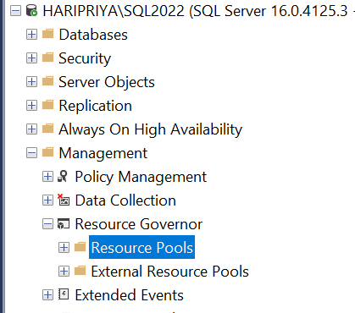
Resource Pool
Limit memory usage
for workloads assigned
CREATE RESOURCE POOL tempdb_resource_pool WITH (MAX_MEMORY_PERCENT = 70);
ALTER RESOURCE GOVERNOR RECONFIGURE;

Slide 24
Resource Pool
Bind Resource Pool to TempDB
ALTER SERVER CONFIGURATION SET MEMORY_OPTIMIZED TEMPDB_METADATA = ON (RESOURCE_POOL = 'tempdb_resource_pool’);
Restart SQL Service!

Slide 25


Slide 26

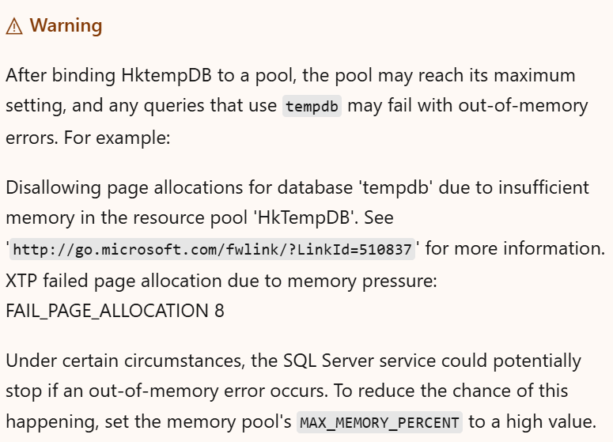
https://learn.microsoft.com/en-us/troubleshoot/sql/database-engine/performance/memory-optimized-tempdb-out-of-memory

Slide 27
Note!
Resource governor/pool for Memory Optimized TempDB
Limits memory usage
This applies to SQL Server 2019 and above
SQL Server 2025 resource governor/pool for TempDB
Limits data file usage
This works regardless of memory optimized tempdb enabled/disabled
This applies only to SQL Server 2025

Slide 28

Memory release - It’s a feature not a bug!

Slide 29

Once you understand how this works

Slide 30
XTP memory consumption
Memory consumed as part of this feature is stored as XTP memory
XTP memory grows without limit and can cause restart

Slide 31




Assume: One-way, single lane road, red car driver is sleeping.
First 3 cars left.
Cars behind red car can’t move.
They can’t be freed up.

Slide 32
T8 T7 T6 T5 T4 T3 T2 T1
Black cars are all committed transactions.
Red car is sleeping transaction.
T8 T7 T6 T5 T4
Cleanup runs – T1, T2, T3 are freed up.
From T4, everything else behind it is stuck.

Slide 33
XTP memory release
Cleanup task runs
3 transactions get cleaned up
7GB released
9:00 Transaction 1 – committed, 2GB
9:01 Transaction 2 – committed, 2GB
9:02 Transaction 3 – committed, 3GB
9:03 Transaction 4 – sleeping , not committed, 2 GB
9:04 Transaction 5 – committed, 2GB
9:05 Transaction 6 – committed, 3GB
9:06 Transaction 7 – committed, 2GB
9:07 Transaction 8 – committed, 1GB
……Transaction 25 – committed, 20GB
……Transaction 70 – committed, 80GB
……Transaction 95 – committed, 100GB
Server blows up when held up memory reaches max server memory
Can’t be cleaned up
10GB is held
Still can’t be cleaned up

Slide 34
XTP memory release
It’s not consuming all the memory
It’s not able to release the memory due to open sleeping transaction
Managing open transactions will help release memory
Resource pool will only limit memory usage and not help with releasing memory

Slide 35

If memory is not released, SQL Server restarts

Slide 36

Check open sleeping transactions

Slide 37

Proactive Monitoring

Slide 38
Set up a SQL Agent job
Alert when XTP memory exceeds 10% of max server memory.
Check for idle transactions lingering for over 5 hours.
Log session details to a table and send you a notification.
Manually terminate the session
Goal: Release memory
GitHub link to the script - https://github.com/haripriyasb/MemoryOptimizedTempDB/blob/main/MonitoringXTPMemory

Slide 39

Limitations
Columnstore clustered index on a
temp table won’t work.
Accessing memory-optimized TempDB
and memory-optimized user table in the
same transaction won’t work.
Restart the service for
Configuration to take effect
Resource pool to take effect

Slide 40
Recap
Addresses pagelatch waits on system objects
Reduces metadata contention
Moves 12 system objects to memory
No more pagelatches
Create or alter temp table
XTP memory keeps growing
Memory release is important
Make sure no long open sleeping transactions
Monitor XTP memory usage with the help of a job

Slide 41
DEMO

Slide 42
Results
Scenario | Without Memory-Optimized Metadata | With Memory-Optimized Metadata
Temp Table runtime | High | Low
Table Variable runtime | Low | Low
PAGELATCH Contention | High | Low
Query Performance | Slow | Fast

Slide 43
Manage this feature efficiently
Jobs | Schedule
Execute sys.sp_xtp_force_gc to release memory | Once every 30 mins
Notify long open sleeping transactions(find repeat offenders) | Once every 4-5 hours

Slide 44

Are you enabling this feature?

Slide 45
When NOT to use this feature
When there are explicit DDL transactions with temp tables running for a long time
Temp Tables with Columnstore clustered indexes
Systems that don’t have contention on TempDB system objects, usually OLAP

Slide 46
Do this before you enable
Strongly recommend to cache temporary objects
Avoid dropping temp tables at the end of stored procedure
TempDB Contention: https://www.youtube.com/live/-3ap1_WWW40?si=LX61gxhrHysBsc8i

Slide 47
Summary
Address metadata contention
Too many stored procedures running concurrently
Not an alternate solution for datafiles
Significant performance improvement with temp tables

Slide 48
Summary – Contd.
Best to enable in SQL 2022 and above
Understand how memory consumption works
Long open sleeping transactions
Proactive monitoring to release memory
Resource pool to limit memory usage

Slide 49
Learn more
https://learn.microsoft.com/en-us/sql/relational-databases/databases/tempdb-database?view=sql-server-ver16#memory-optimized-tempdb-metadata
https://learn.microsoft.com/en-us/sql/relational-databases/databases/tempdb-database?view=sql-server-ver16#limitations-of-memory-optimized-tempdb-metadata
https://learn.microsoft.com/en-us/troubleshoot/sql/database-engine/performance/memory-optimized-tempdb-out-of-memory
TempDB Contention: https://www.youtube.com/live/-3ap1_WWW40?si=LX61gxhrHysBsc8i

Slide 50
Questions?
gohigh.substack.com
linkedin.com/in/haripriya-naidu1215/
https://github.com/haripriyasb/MemoryOptimizedTempDB/
Thank You!

